Slide 1
Troubleshooting
Week 7a

Slide 2
Today’s Goals
DC power supply labs comments
Let’s make sure all your power supplies are working
Who’s isn’t working, or you’re not sure?
Final portfolio
Questions about Transistors?
Misconceptions
Next time we’re going to start AC, and things are going to get much more mathematical and abstract for a day or two

Slide 3
Final Portfolio
Grades are pretty low now … so we can make the final grading rubric so 50% (or more) of your final grade is based on your resubmitted lab reports
I’ve made a lot of comments on your graded lab reports
I try to be constructive in comments (but Warning: electronics joke coming: because I work with op-amps a lot, I prefer negative feedback)
A big part of your final grade is will be from a portfolio of lab reports
Redoing them gets easier with practice
Rewriting them gets easier when the data is good
Lab portfolio may add to your CV to share with future hiring managers or grad school admission committees.
Send me next drafts to review anytime (don’t wait until Final’s week, start now), as many times as you want
Questions?

Slide 4
Does anyone need help troubleshooting?
You do if your power supply isn’t working right now …

Slide 5
What’s the point of a lab?
To reveal some facts about Nature
Demonstrate or validate some techniques
You are being equipped with tools to …
Troubleshoot and fix why something isn’t working as it should
Make devices with new functionalities
Discover new things

Slide 6
What are your most important tools?
Reductionism – the skill to systematically break tasks down into smaller pieces that don’t overwhelm you
Observational/experimental skills, attention to detail, so you can see and understand what’s in front of you
Learn to see and interpret subtle signs
Nature rarely reveals her secrets easily …
“The job of a scientist is to listen carefully to nature, not to tell nature how to behave.” – Richard Feynman
Creativity to come up with hypotheses and tests to narrow (reduce) your uncertainties
Intelligence, organization, and perseverance to put the pieces back together and build a working whole
…

Slide 7
Questions on Lab Reports
Should the LM317 schematic be in future lab reports?
I don’t think so … each report has it’s objectives (e.g., automating i-v curves, measuring hfe, …) and the LM317 schematic is “under the hood”
You can mention in the Methods that a ”variable DC power supply was used, and footnote the LM317 lab report
Your final “project” is a portfolio of your lab reports, edited, corrected, redone if necessary (thanks to automation, that’s not so hard), so the referenced report will be nearby

Slide 8
Let’s confront misconceptions
From the syllabus:
Prerequisites: Phys 101 or 201: introduction to physics and calculus.
… [← we started with a review of this … but perhaps you didn’t take it seriously enough?]
Student Learning Outcomes
understand the basic principles, concepts, and languages of analog and digital electronics
start to think like electrons behave
learn about common electronic components and how to build circuits with them
understand and use schematic diagrams and component data sheets, EDA tools (free Eagle software); and (free) Matlab to analyze data and automate experiments and more.
use electronic test equipment including multimeter, oscilloscope, signal generator, power supply
appreciate the role of electronics in data acquisition, metrology, and control in other fields
Automate experiments, measurements, data acquisition, data analysis, and report generation.

Slide 9
Let’s confront misconceptions
From the syllabus:
Seeking help
This subject isn’t easy. We have no natural, innate experience with the behavior of weak electricity in exotic (i.e., semiconductor) materials. Your prior experience with gravity, weather, etc. doesn’t apply. So open your mind to unlearning and learning new ways of thinking. Open your mind to being wrong. Share your thinking with other students – speaking about it helps you rewire your brain.
Many of the labs will involve building your own test equipment (a power supply and function generator). This electronic apparatus will be yours to keep after the semester (you keep the toolbox too). Subsequent labs will thus depend on previous ones. Getting these circuits working is not optional, it’s required. After staring at the circuits for hours and they refuse to comply, another set of eyes maybe necessary. Seek help from (and be available to help) your classmates. The STEM Center and LRC offer tutoring and help. If you don’t ask for a TA, then we won’t get one ... if there is demand, the University will pay a former student to take on this role – so asking for help now might also create a job opportunity for you in the future. Two lab techs may have time to help you, but respect that they are busy: maximilian.seligman220@myci.csuci.edu and theo.porche@csuci.edu support Mechatronics and Physics. Finally, email me and we can set up a Zoom if you can’t make my Student Hours on Zoom. If you’re troubleshooting a circuit, have some good photos of it to

Slide 10
Let’s confront misconceptions
Most of your LM317 lab reports did not convince me that your power supplies were working
How can you get a C = satisfactory, or B = very good, or A = excellent grade for something that doesn’t work, that doesn’t achieve it’s stated objective?
The prompt: (I’m giving you lots of direction, but you gotta walk …)
Objective: build an adjustable DC power supply.
Methods: describe the design (include schematic), construction techniques, and testing methods. [Did you breadboard?]
Results: Include photos of both sides of the board. Have your 3-digit display working and indicate the min and max voltages that you measured. With voltage set ~10V, briefly (because it will get hot) connect a 100 ohm resistor to the output and note how well the voltage is regulated (can you estimate the power supply's Thevenin resistance?).
Discussion: What did you learn? Any surprises? Any suggestions to your future self or someone else on how to troubleshoot it?

Slide 11
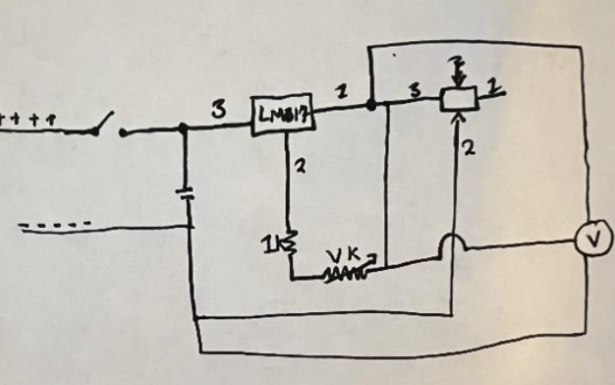
Schematics
Are a graphical language to help us think and communicate
They don’t convey their history and evolution – to do that, you need to draw more than one …
I’m not smart enough to understand this one:
Too many loops, unidentified components, is the vertical wire next to Vk (?) connected (no dots indicating connections)?; is the pin on right labeled 2 the circuit’s output [No], …
Unless you’re much better than me at reading schematics, (with 40+ years of practice). this won’t help you much …

Slide 12
Schematic hints
Practice observing & remembering, details and copy the patterns you see others use
Label inputs and outputs, e.g., Vin, Vout, …
Name every part, e.g., R1, C1, L1, D1, Q1 (or T1), …
Use ground symbols and power symbols (e.g., +5, Vcc, …), to reduce the number of crisscrossing wires
Try to make signals or power flow left to right and top to bottom (when possible)
Use a ruler, graph paper, … to make your drawings neater
Mechanical pencil and a good eraser help
Being neat is never penalized, being messy can be …
Practice habits that will help you hold and advance in jobs
Double and triple check – mistakes get much more costly in time and effort to fix the longer they persist

Slide 13
DC Power Supply Lab Comments
Methods
“I used relevant data and figures in the datasheet …” is too vague to be useful. Be explicit, which data, which figure led you to which engineering decision?
You’re describing a path through the jungle of data. What are the landmarks or features that guide you? Just following Rasnow doesn’t teach you how to navigate this intellectual terrain …
Significant figs. Is 39.98±.49mV identical to 40±.5?
Numerically, yes, but conceptually, the later (simpler) one is BETTER
Strain relieve wires that can move or pull (and never use solid wires if they’re going wiggle or move)

Slide 14
DC Power Supply Lab Comments
Bending component leads
Leads should come straight out of parts and then bend without a kink
If they bend against the part, it can cause stresses leading to failure (especially in aerospace and high vibration/thermal/g-force environments)
This is a good habit to start adopting now
Photoshopping – crop, rotate, adjust parameters to maximize the information content (and aesthetics) of your pictures
I suggest you label your figures and include captions. Thinking about caption focuses your attention on why this figure is included, what is it showing, can it be improved?
These little attentions to detail help you overcome other handicaps or weaknesses in the competitive workplace
I’m setting a high bar that I’m confident you’ll get over with practice …
Cheap lead bender, e.g.,
https://www.ebay.com/itm/294228621200

Slide 15
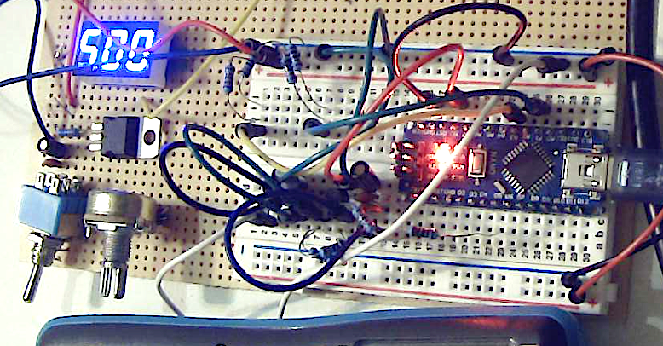
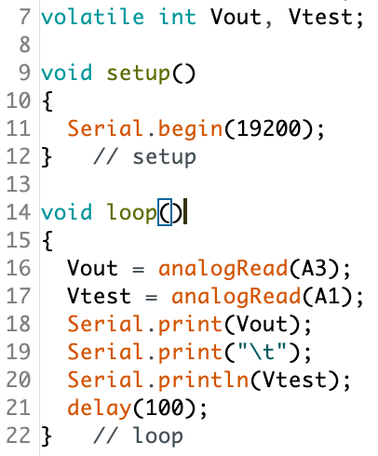
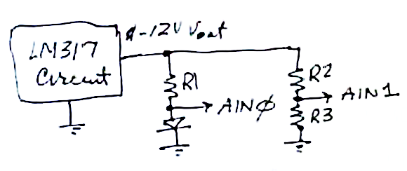
Revisiting the i-v lab
I reconstructed the I-V curve circuit on the top-left corner of my breadboard …
R2
R3
R4
R1
Vtest
Vout
R1 = 1k; R2 = 22k; R3 = 10k;
Diode replaced with R4=100Ω

Slide 16
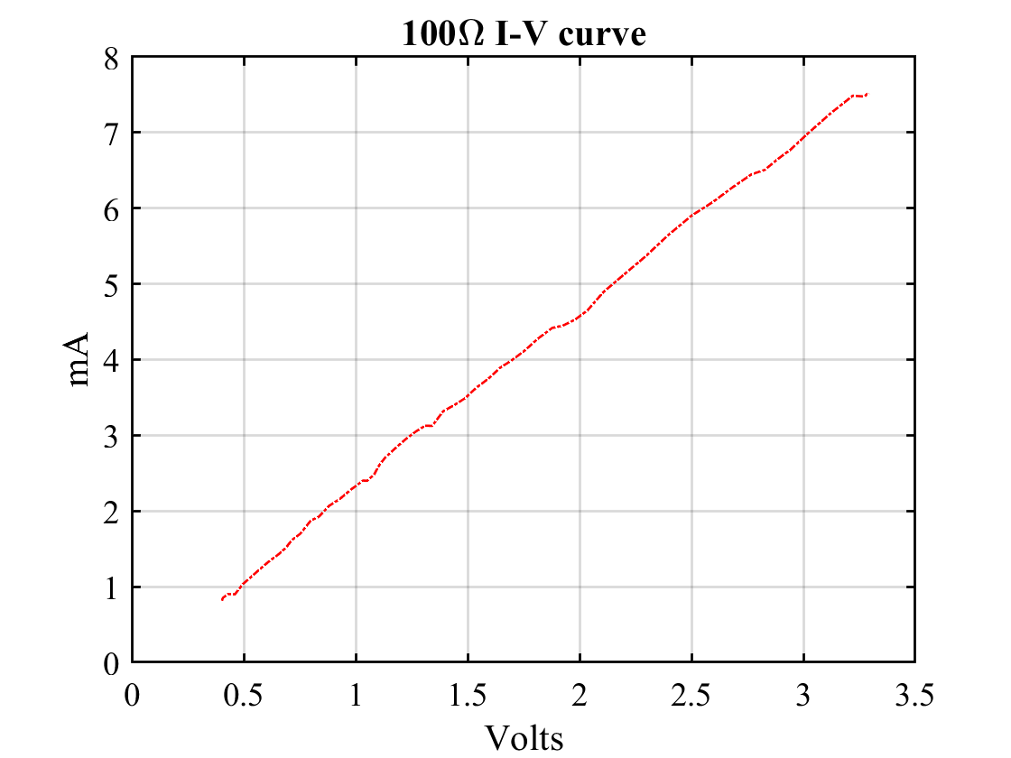
Revisiting the i-v lab
data = [... % Vout Vtest
... % paste from Arduino
];
Vref = 4.576; % volts
Vout = data(:,1) * Vref/1023 * 3.2;
Vtest = data(:,2) * Vref / 1023;
Itest = (Vout-Vtest)/1; % R=1k->mA
plot(Vtest, Itest,'-.');
xlabel('Volts'); ylabel('mA');
title('100\Omega I-V curve')
Grid
Look good??
The slope is WRONG!! 3V/7mA ≠ 100Ω! → What to do??

Slide 17
Checked and doublechecked …
The data is what it is … but it’s wrong → what to do?
➔ Simplify the apparatus
E.g., don’t try to troubleshoot your car while driving down the highway
Can you tell if the problem is SW or HW?
Connected Vout and Vtest
Running the same software, I should get repeated values & I do … sort of, they are similar, but why is the standard deviation of Vtest ~7 * std(Vout)?
These strange facts didn’t speak to me loud enough, I still didn’t grok the problem → what next?
Changed voltage and both moved together
I suspected hardware, so changed the AIN pin, moved the wire, reloaded SW → no chg.
But at least we’re debugging a simpler circuit
DVM sees different voltages at Vtest & AIN1
→ why are they different??
>> data = [...
% Vout Vtest
687 681
688 680
687 679
…
687 675
687 676
687 675
687 675];
mean(data)
ans =
687.2353 675.8824
std(data)
ans =
0.4306 2.7827

Slide 18
Troubleshooting cont’d …
Suspecting SW ➔ Reread Arduino → Help → Reference → AnalogRead()
Arduino → File → Examples → O1.Basics → AnalogReadSerial has the line: delay(1); // delay in between reads for stability
Tried that → no change.
Suspecting AIN1 is fried, connected it with a different jumper wire to ground → reading 0±0 ADU – good, not fried
Other jumper from Vtest back to AIN1 → same problematic behavior
I think I figured it out now … the next test is …
Hint: ohmmeter …
Confirmed a bad (f*&^#ing) jumper wire
Instead of Widlerizing it immediately, I put tape on it (immediately) to show you (and never use it again) … there is no visible sign of its infinite resistance

Slide 19
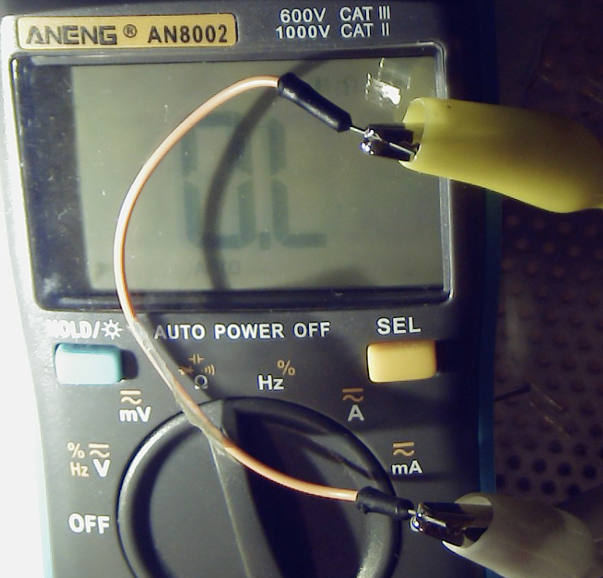
Trouble found … reflecting
Data → Knowledge → Understanding
Without a connection, AIN1 floated to a value close to the other AIN (likely via “parasitic capacitance”)
The high std was probably Johnson noise (R_{test} = 100Ω wasn’t in parallel with the large internal Zin because of the open jumper)
…
There are ~10 jumper wires on the breadboard so perhaps ~10% failure rate is expected …
Problem localized to open circuit between clip leads
In other words, I was measuring garbage – parasitic capacitance and Johnson noise – and got a visually pleasing I-V curve from it that almost fooled me

Slide 20
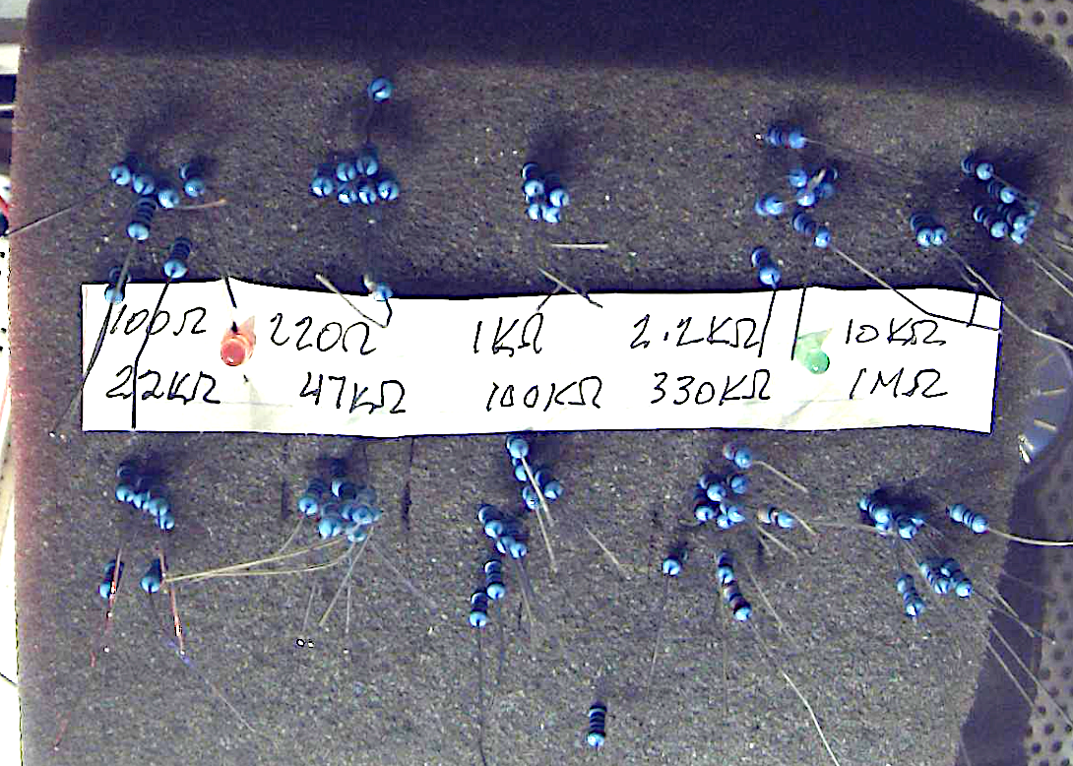
Another tool …
Another “rabbit hole” distraction … I got tired of constantly checking resistors with the ohmmeter → found 4”x5”x1” foam

Slide 21
Unwrapping this adventure
Organization skills … done with this rabbit hole, find the next one … where were we?
Meta-question: was our method “bottom-up” or “top-down”?
Top down – we built the circuit and drilled down into the problem
Given its cost, should we test every jumper wire first (bottom up)?
Maybe … but it won’t guarantee that one that tests good now will be good tomorrow … if they fail later, we have little choice but top-down testing
Although sometimes, perhaps out of frustration with top-down troubleshooting, you rip the system apart, and start over (bottom-upping)
Humans (and especially engineers and physicists) are tool users
Whether intellectual tools like calculus or hardware like soldering irons …

Slide 22
Questions? Comments?

Slide 24
What next?
Continue automating data acquisition and control
Eliminate copy/paste from Arduino to Matlab – let’s automate communication between Arduino and Matlab
Automate “turning R2” to vary the LM317 voltage – control the LM317 via Matlab, via Arduino
Why should we do this?
You’ve experienced how the manual methods we’ve used are inefficient
Achieving the two above steps would enable full automation of i-v, hfe, etc. curves
We’ll learn a lot in the process, in particular, #2 will let us apply some transistor circuit ideas and introduce us to AC circuits …
How do we do this??
General reductionist approaches are “top-down” and “bottom-up”
Top-down starts at the goal and works “downward” completing details
Bottom-up starts with necessary details, working towards the final solution
If you know what you’re doing, top-down can be more efficient – keeps you from wasting time on unnecessary adventures
If you’re unsure about the final solution, then focusing on necessary parts gives you time to reduce uncertainties and figure out the top
Which is better??
Questions??

Slide 25

Arduino meets Matlab
Arduino has a USB port … What is USB?
It’s pretty Universal, it’s Serial (vs. parallel), and it’s a Bus …
It’s a polished turd (https://www.edn.com/polishing-a-turd/ -- the date of this article is wrong)
An industry standard (https://en.wikipedia.org/wiki/USB) – “a nice thing about standards is there are so many to choose from”
It’s what we got to connect computers to peripheral devices like microcontrollers … and we use what we got
It’s inherited a long legacy of prior serial hardware and software protocols
Yea, it’s a well-polished turd …
Matlab can connect to serial ports
Matlab’s interfaces have changed, >> doc serialport is the current one
On the left side of the help browser, see Examples, and also at the very bottom is “See Also: Functions: serialportlist
Is this the only way?
https://www.mathworks.com/products/hardware/arduino.html describes a higher level interface (that we will not be using)

Slide 26
Serial ports cannot be shared
Windows, Unix, MacOS don’t allow multiple processes (active programs) to share a serial port
If the Arduino IDE is connected to the Arduino, then Matlab cannot connect to it, and visa-versa
Some programs maybe more aggressive and “steal” the port, but usually you get an error, “port not available” or a more cryptic equivalent, if you try to connect to an Arduino that’s already connected to another application
Disconnect or quit IDE before trying to connect Matlab and visa versa – a pain of sharing hardware …

Slide 27
Arduino meets Matlab
On my Macbook Pro:
>> ports = serialportlist
ports =
1×6 string array
Columns 1 through 4
"/dev/cu.lupeOldsBe…" "/dev/tty.lupeOldsB…" "/dev/cu.Bluetooth-…" "/dev/tty.Bluetooth…"
Columns 5 through 6
"/dev/cu.usbserial-…" "/dev/tty.usbserial…”
Note the … -- we’re not seeing the full names of these 6 strings
On a PC, you should get results like "COM4" , …
Which one is the Arduino?
There are complex handshake protocols to query USB devices for their ID. My goal was the quickest, simplest, solution: trial and error.
Unplug the Arduino and see which one disappears …
Turns out on my Macbook Pro, the Arduino is always (so far) the last one

Slide 28
Arduino meets Matlab
>> ard = serialport(ports(end),9600)
Error using serialport
Unable to connect to the serialport device at port '/dev/tty.usbserial-112420'. Verify that a device is
connected to the port, the port is not in use, and all serialport input arguments and parameter values
are supported by the device.
See related documentation for troubleshooting steps.
>> % quit the Arduino IDE to free the port
>> ard = serialport(ports(end),9600)
ard =
Serialport with properties:
Port: "/dev/tty.usbserial-112420"
BaudRate: 9600
NumBytesAvailable: 0
Show all properties, functions
>> ard.Timeout = 1;

Slide 29
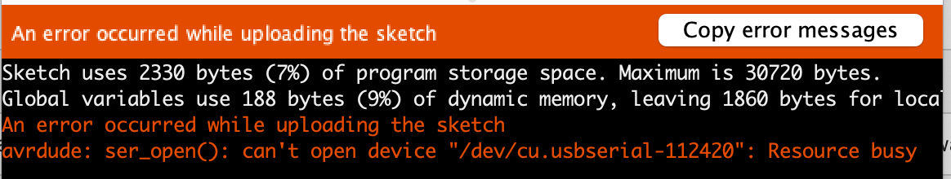
Arduino meets Matlab
I forgot to program the Arduino, so I opened the IDE and tried to upload:
>> clear ard % free the port
Now it uploads without error. Instead of quitting the IDE, I
>> ard = serialport(ports(end),9600)
ard =
Serialport with properties:
Port: "/dev/tty.usbserial-112420"
BaudRate: 9600
NumBytesAvailable: 0
Show all properties, functions
>> ard.Timeout=1;

Slide 30
Arduino meets Matlab
Arduino is running Transistor Switch program, printing tab-separated A0, A1, A2 at about 5 lines per second, when D5 is grounded. Ground D5 for a few seconds and query (use Tab-completion so you don’t need to type the entire command):
>> ard.NumBytesAvailable
ans =
156
So there’s data in the serial object – how do we read it? >> doc serialport suggests two answers: read and readline:
>> data = readline(ard)
data =
"1023 374 99
"
That is promising – the data is a string of ascii characters, which can be turned into numbers by
>> str2num(data)
ans =
1023 374 99
But this one line, we’ll need to keep reading until the serial buffer is empty.

Slide 31
Arduino meets Matlab
Arduino is running Transistor Switch program, printing tab-separated A0, A1, A2 at about 5 lines per second, when D5 is grounded. Ground D5 for a few seconds and query (use Tab-completion so you don’t need to type the entire command):
>> ard.NumBytesAvailable
ans =
156
So there’s data in the serial object – how do we read it? >> doc serialport suggests two answers: read and readline:
>> data = readline(ard)
data =
"1023 374 99
"
That is promising – the data is a string of ascii characters, which can be turned into numbers by
>> str2num(data)
ans =
1023 374 99
But this one line, we’ll need to keep reading until the serial buffer is empty.

Slide 33
What next?
Continue automating data acquisition and control
Eliminate copy/paste from Arduino to Matlab – let’s automate communication between Arduino and Matlab
Automate turning R2 to vary the LM317 voltage – use the Arduino to control the LM317
Explore AC … time varying voltages and signals, for the rest of the semester
Build a function generator
Construct an oscilloscope (in software) to display time-varying signals
Automate control of function generator’s frequency
We’ll mix up 1 and 2 because we’ll need some AC concepts to achieve 1.
Shall we do a Transistor Midterm first, to test our understanding???

